Slide 1
Autonomous Mobile Manipulator
Project Execution Plan and IP Landscape presentation
Tom Queen and Daniel Gregory-Turner
Abstract / intro
Notes:
2 mins

Slide 2
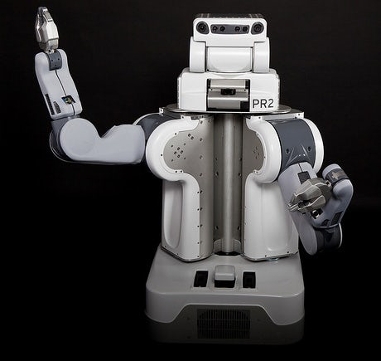
Research Question
Can a compliant robot arm be integrated into a self-navigating robot platform and programmed to autonomously to identify, locate, grasp and transport objects using data from cascaded camera systems with comparable reliability to existing systems as a function of development time and cost?
Notes:
45 seconds

Slide 3
Research Objectives
Evaluate current methods of autonomous object fetching with respect to functionality and reliability as a function of cost
Explore methods of camera based object recognition and localisation from cascaded camera systems, and the interaction between these systems
Investigate and develop a novel approach to grasping a variety of objects
Build a system capable of autonomously navigating an environment, locating a desired object and transporting the object to a location with comparable reliability to existing systems as a function of development time and cost.
Notes:
One min

Slide 4
Project description and objectives
Requirements:
Object recognition
Object localisation
Navigate to object
Positioning gripper
Object grasping
Location storage
User interface
E.g:
Verbal?
Notes:
1:30

Slide 5
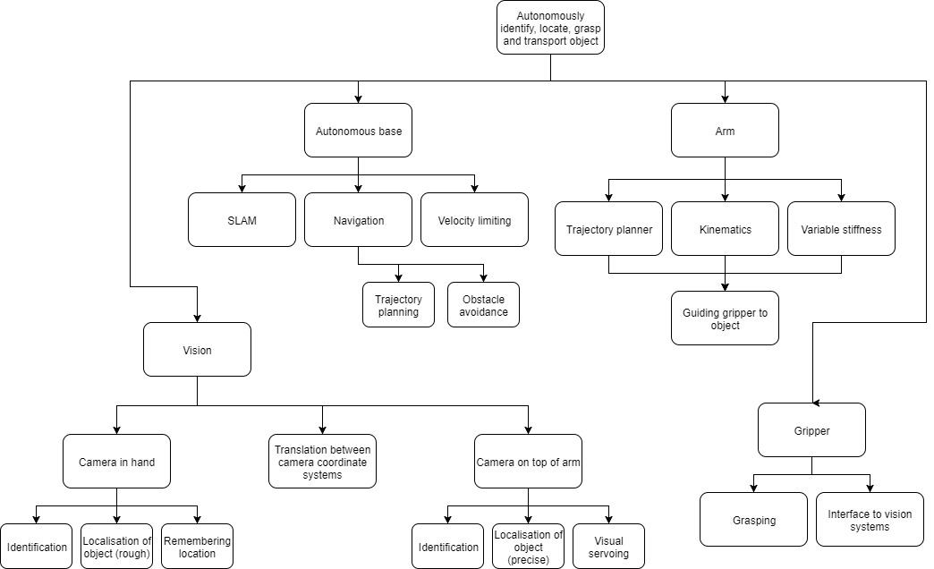
Systems Breakdown
Notes:
30 secs

Slide 6
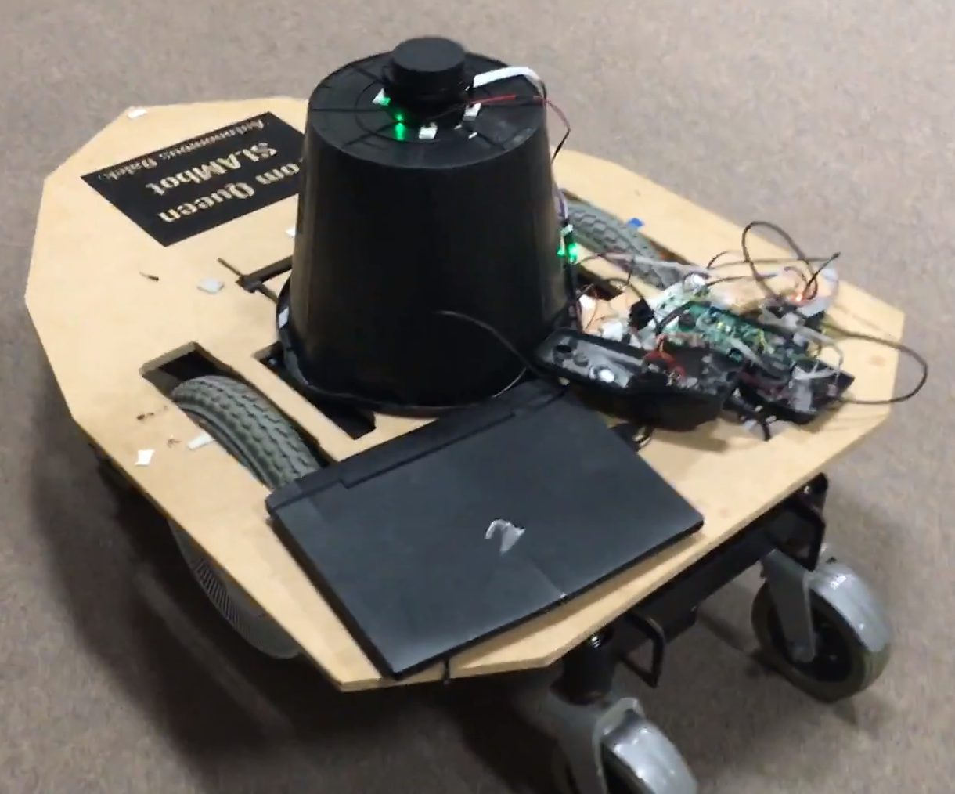
Systems overview
Hardware
Arm
Base
Gripper
Cameras
Software
ROS
Vision algorithms
Waypoint node
Control
Notes:
2:30

Slide 7
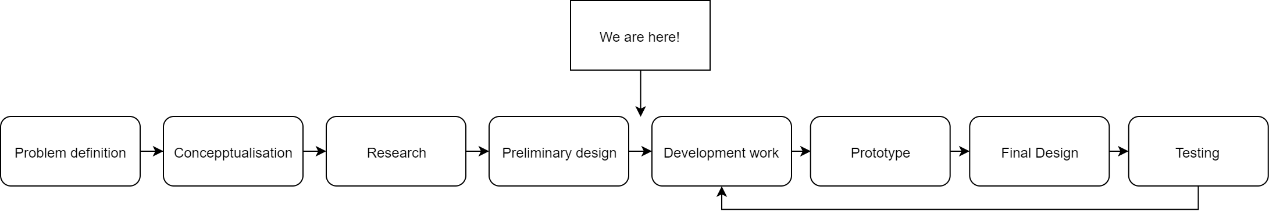
Design Process
Testing examples

Slide 8
Project Management
Example - Systems architect:
High-level design of system architecture
Identifying and specifying requirements of software subsystems
Structuring software subsystems
Specifying requirements of subsystem interfaces
Testing the interaction between subsystems
Philosophy:
Traditional project management theory
Adaptive path method
Roles and Responsibilities
 | Project manager | Electrical manager | Mechanical manager | Software manager | Systems architect | Financial manager
Tom | X | X |  |  | X
Daniel | X |  | X | X |  | X

Slide 9
Risk Management
Brainstormed potential risks to project
Gave each risk a probability and impact score
Risk priority is the product of the probability of the risk occurring and its potential impact
Description of Risk | Probability (1-10) | Impact (1-10) | Priority (1-100) | Triggers | Response Plan
Gripper self-destructs, breaking servo | 3 | 5 | 15 | Servo breaks | Replace servo with spare and order another spare

Slide 10
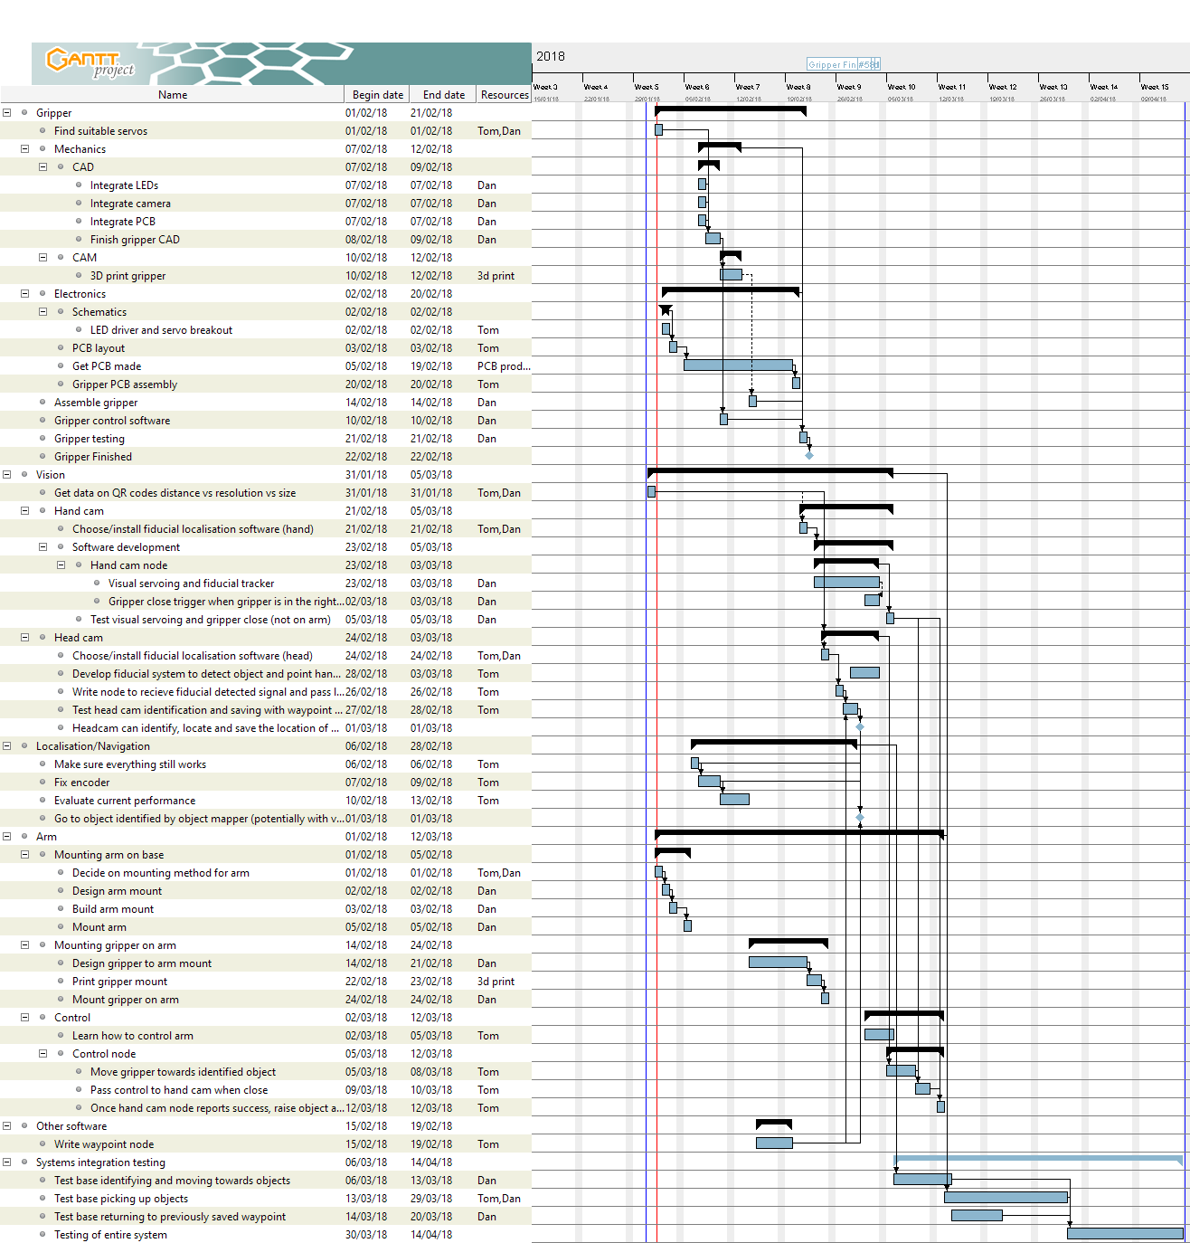
Time plan

Slide 11
IP Landscape
Generalness regarding robotic systems:
All SLAM robots
Aquire, process, visualise
General Gripper

